Slide 1
Java SE 17 – Presentation
Chapter 8 – Lambdas and Functional Interface

Slide 2
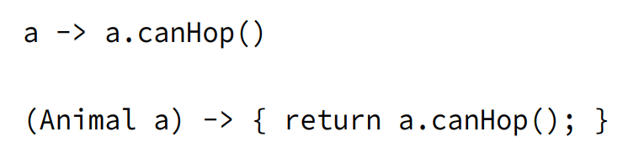
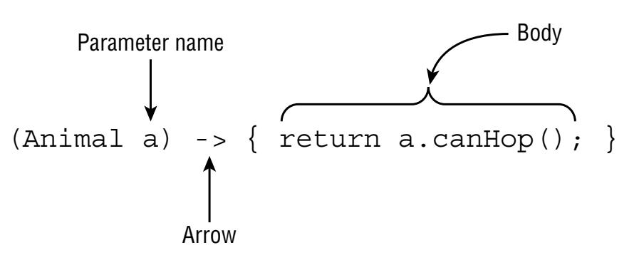
Revision
- We can understand Lambda as ... in a ... class
- Note: We can only use Lambda with ...
(code illustration snippet 1,2,3,4)
- Deferred execution is ...

Slide 3
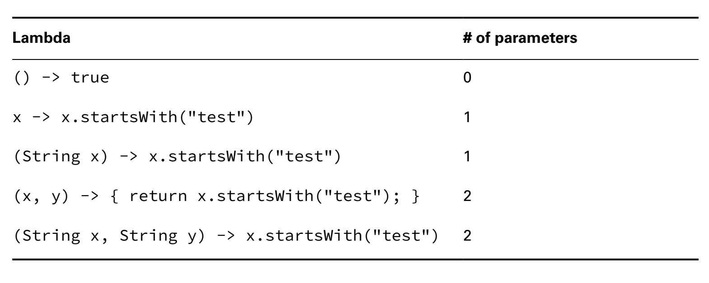
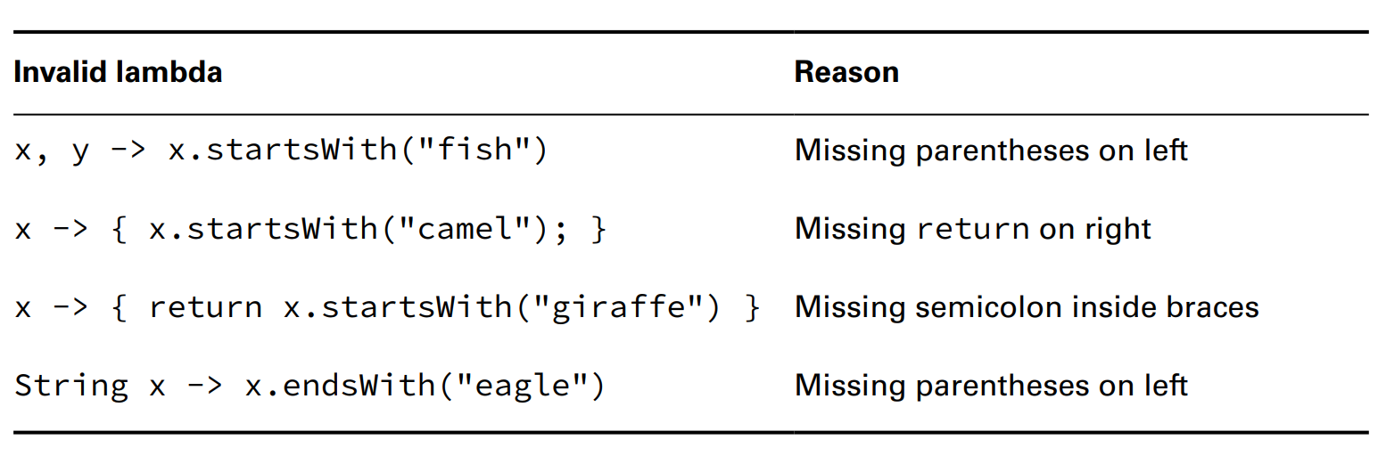
Revision

Slide 4
Revision
Assigning Lambdas to var
- We ... assign ... to var because ... lambda needs
Coding Functional Interface
- As we know that we can only use ... with ...
- ... is offically called ... (... only has ...)
Defining a Functional Interface
(code illustration snippet 5)
- The annotation ... will ... that this interface will ... If the interface doesn't ...
(code illustration snippet 6)
- Java includes the ... some ... however not ...
– An interface without ... doesn't mean ... Remember that ...
(code illustration snippet 7)

Slide 5
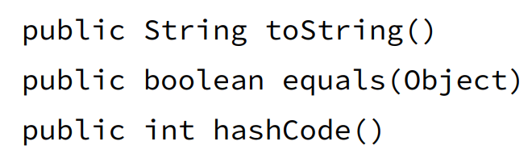
Revision
Adding object methods
- There is a rule in ... that if a ... declares ... that is the same ... => that ... won't be considered as ... interface
- Note: JLS allows ... from ... class to ... from ... interface... with some rules
+)
+)
+)
- However, JLS also points out that if the ... is from ... class => another rule must be satisfied which is ...
(code illustration snippet 8)

Slide 6
Revision
Using Method Reference
- Method Reference is ...
(code illustration snippet 9)
- However, that syntax is ..., therefore, we can ...
(code illustration snippet 10)
- The colons are used for ...
– There are ... types of Method Reference
+)
+)
+)
+)
Calling static method
(code illustration snippet 11)
- How does Java know to pick ..., it is because the ... in ... class ...

Slide 7
Revision
Calling Instance methods on a particular object
(code illustration snippet 12)
- Method reference doesn't require ... but with ... conditions, which are ... and ...
(code illustration snippet 13)
(code illustration snippet 14)
Calling instance methods on a parameter
- In this section, we will use ... with ... in ... interface ....
- The trick here is that we won't ...
- The only condition to ... is the ... must not ...
(code illustration snippet 15)
- Also we can combine ...
- The first ... will be ... and the second ... will be ...

Slide 8
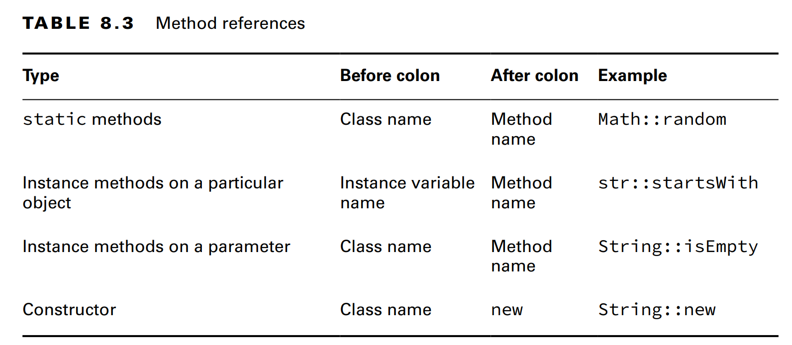

Revision
(code illustration snippet 16)
Calling Constructor
- ... reference is a special ... because instead of using ... it uses ... and it ... instead of ...
(code illustration snippet 17)
- If the ... method has ... => ... reference will ... it
(code illustration snippet 18)

